Slide 1
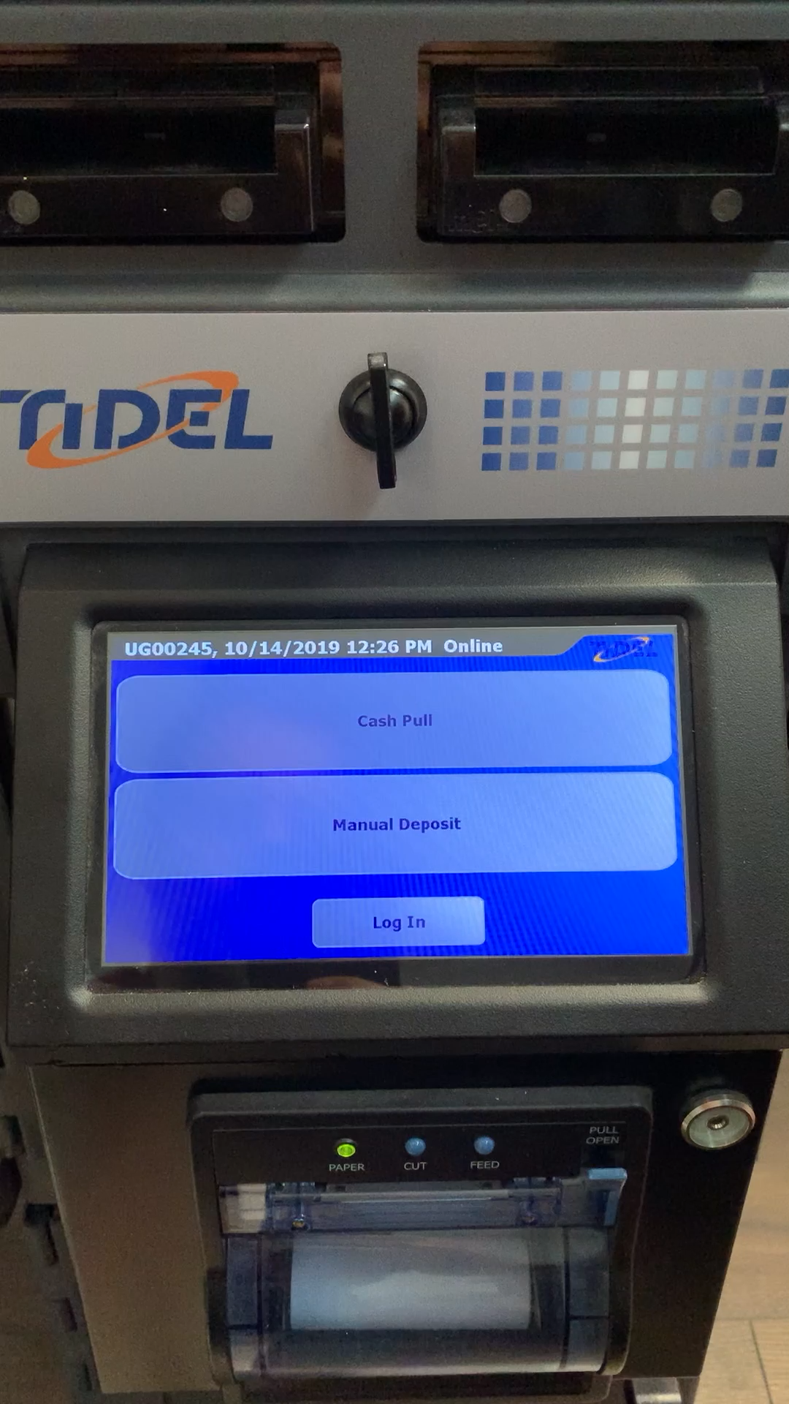
MANUAL DROPS
MANUAL DROP
Manually enter a deposit amount for damaged / rejected currency on the Smart Safe as shown in the video below.
Notes:
Attendees – nice printed list
Agenda – gets printed

Slide 2
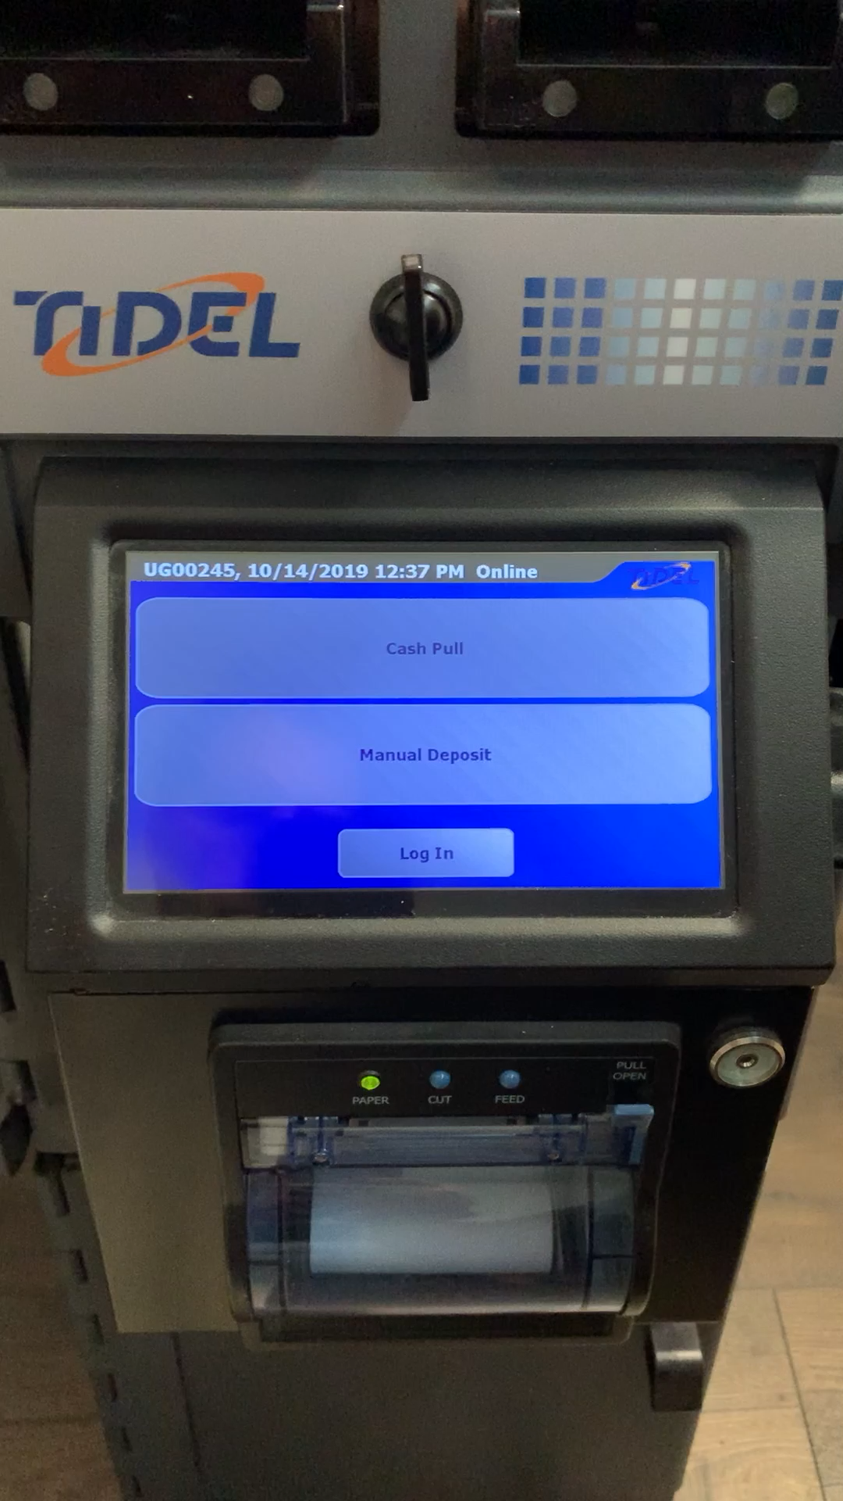
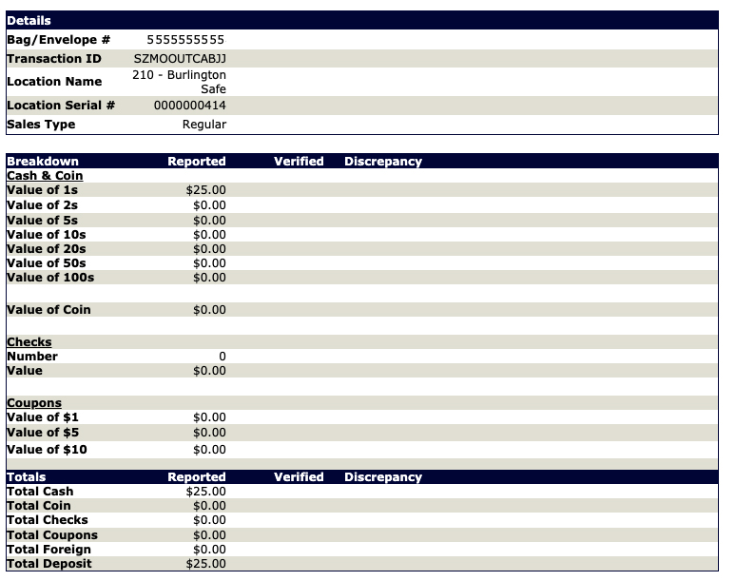
MANUAL DROPS
FINALIZE
Use the Smart Safe to finalize the manual drop. Once completed, the safe calls out to the DTS Connex Deposit API receiving back a DTS Connex advice.
DTS Connex updates deposit search screen with manual drop details.
Notes:
Attendees – nice printed list
Agenda – gets printed

