Slide 1
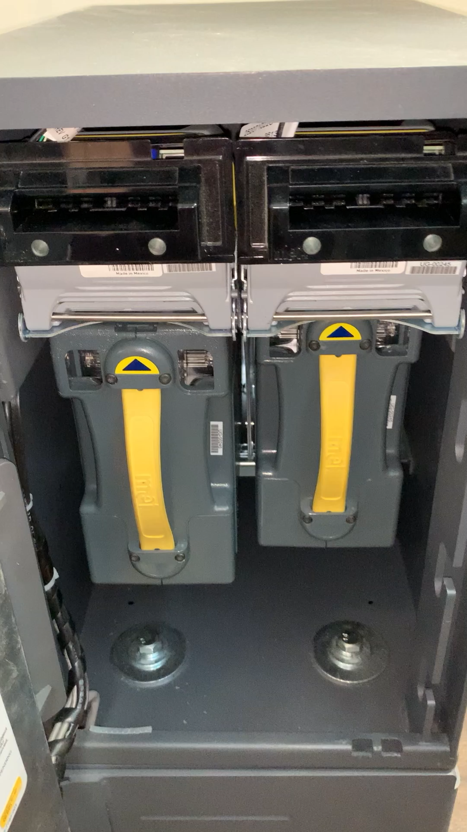
SMART SAFE DEMO USING THE DTS CONNEX PARTNER API
PARTNER API
This video shows a DTS Connex Deposit Advice printed from the safe after the content removal is completed.
Once the safe is put back in service it calls the DTS Connex Partner API.
Notes:
Attendees – nice printed list
Agenda – gets printed

Slide 2
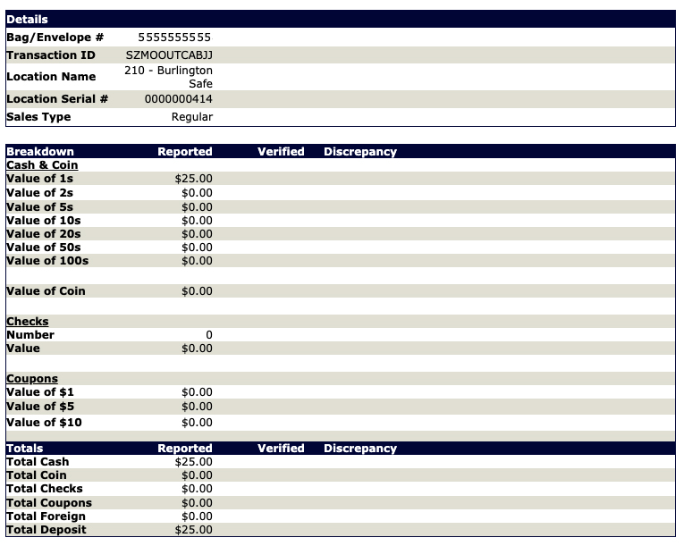
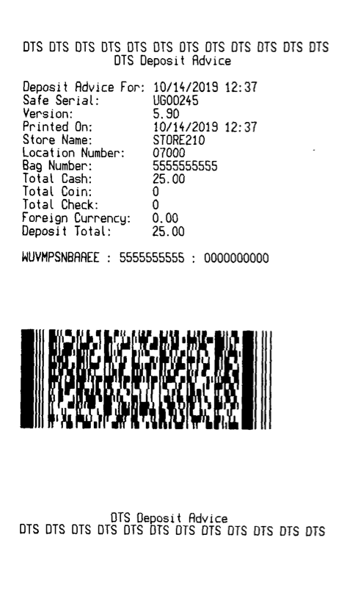
DEPOSIT ADVICE
DTS Deposit Advice from Safe
DTS Connex logs the deposit information and returns a deposit advice which is printed on the smart safe.
Notes:
Attendees – nice printed list
Agenda – gets printed

